Slide 1
D6780 Grant Qualification & Management Seminar
TITLE
Fall 2022
For the 23-24 Rotary Year

Slide 2
Welcome!

Slide 3
Have you been to training before?

Slide 4
Club completed a district grant?
Notes:
1. How many times have you attended grants certification training?
a. Never
b. 1-3
c. 4-5
d. 6 or more
2. Has your club ever completed a district and/or global grant?
a. No
b. Yes, district grant only
c. Yes, global grant only
d. Yes, both
e. I don’t know
3. If your club has completed a DG or GG, how many have you done?
a. One
b. Two
c. Three or More
d. Don’t know

Slide 5
GOALS FOR TODAY
Understand the basics & timeline
Understand how to successfully manage a District Grant
Understand stewardship expectations

Slide 6
GOALS FOR TODAY
Be able to complete the Memorandum of Understanding (MOU)
Qualify clubs with members attending to receive Rotary Foundation grant funds & participate in TRF programs

Slide 7
AGENDA
OVERVIEW Debbie & Beth
CLUB QUAL David & Linda
CREATING A PROJECT Beth
APPLYING FOR A DISTRICT GRANT Pat
PROJECT IMPLEMENTATION Pat & David

Slide 8
OVERVIEW
Debbie Alexander-Davis
District Rotary Foundation Chair
Beth Stubbs
RI Director-Elect

Slide 9
23-24 DISTRICT GRANT TIMELINE
PE and Club identify project in 2022
Club becomes qualified to submit a district grant application by
  Attending training (2 members involved with project)
  Submitting Club Memorandum of Understanding and Club Qualification Plan – may be submitted prior to application being submitted or submitted together

Slide 10
23-24 DISTRICT GRANT TIMELINE
Applications accepted Oct. 8, 2022 to Jan. 31, 2023
Applications reviewed & approved beginning 02.01.23
All DG applications are bundled and submitted to The Rotary Foundation for approval – target date 05.23
TRF approves the bundled district grants & clubs are notified they may begin their project – target date 06.23

Slide 11
23-24 DISTRICT GRANT TIMELINE
Project is carried out
Progress report due midway through the project and no later than October 1, 2023
Final report due by May 31, 2024 including receipts for all expenditures
District disburses funds on approval of final report

Slide 12
FUNDING BASICS
Must be humanitarian but NOT limited to 7 areas of focus
May be local or international
Funded by donations D6780 Rotarians made 3 years prior to the Annual Fund
For 23-24, donations from the 20-21 Rotary year fund District Grants

Slide 13

Rotary’s Seven Areas of Focus

Slide 14
DISTRICT AND GLOBAL GRANT FUNDING
Annual Fund Donations from 3 Years Prior
47.5%
SHARE
47.5%
District Controlled
Trustees Controlled
District Designated Fund
World
Fund
Other
(Cash, DAF, Endowment Fund)
50% (min)
District Grants
Global Grants
(World Fund match
to DDF and Other
50% (max)

Slide 15
2023- 2024 Funding
Annual Fund Donations 2020-21 = $531,619
47.5%
SHARE
47.5%
District Controlled
Trustees Controlled
$252,519
$252,519
District Designated Fund
World
Fund
Other
(Cash, DAF, Endowment Fund)
50% (min)
$126,260
$126,260
District Grants
Global Grants
(World Fund match
to DDF and Other
50% (max)
Notes:
15

Slide 16
Grant Management – Ensures that your grant:
Has proper financial controls in place
Is guided by humanitarian & educational principles
Meets the needs of the beneficiaries
Fulfills objectives based on a community assessment
Safeguards donor funds

Slide 17
Stewardship
Responsible management & oversight of funds
  Rotarian supervision
  Standard business practices
  Irregularities reported to TRF
  Projects implemented as approved
  Financial records reviewed
  Reports submitted in a timely fashion

Slide 18
Terms of Qualification
Valid 1 Rotary Year Only – Clubs qualify each year
“Club” is responsible for use of funds
Potential conflicts of interest must be disclosed
Club must cooperate with all audits
Grant funds must be used properly

Slide 19
CLUB QUALIFICATION
Linda Shults
District Grants Forms Coordinator
David Carroll
District Grants Chair

Slide 20
Qualification Requirements
Attendance at this district Rotary Foundation Grant Management Seminar by 2 club members
Agreement with Club Memorandum of Understanding (MOU)
Submission of Club MOU & Qualification Plan
District Approval of Club Qualification Plan

Slide 21
Club Requalification
Required annually
Review last year’s Qualification Plan
    Do you understand what was written?
    Did you do what you wrote?
    Was it good enough?
Modify & resubmit Qualification Plan
Sign new Memorandum of Understanding (MOU)

Slide 22
Maintaining Qualification
Follow the terms of the Club MOU
Fully implement stewardship and grant management practices to prevent misuse of funds
Appoint a club member or committee to manage club qualification

Slide 23
Club Qualification Plan
What MOU requirements does your club already implement?
What requirements does your club need to implement?
What type of club members would be good choices to help implement the Club MOU?

Slide 24
Best Practices/Issues
Manager
Conflicts of Interest
Training
Bank Account
Financial Management Plan
Document Retention
Reports
Misuse Plan
Approval

Slide 25
Overview & Club Qualification
Questions?

Slide 26
CREATING A PROJECT
Beth Stubbs
Rotary International
Zones 30 & 31
Director Elect

Slide 27
Objectives
Identify best practices for choosing a project
Develop a plan to implement your project
Understand what is needed to establish a financial management plan

Slide 28
Successful Grant Projects
Meet real community needs
Have frequent personal partner communication
Have implementation plans with measurable goals and outcomes
Are sustainable beyond the life of the grant
Practice proper stewardship of grant funds

Slide 29
Community Assessment
Talk with partners and members of the community
Assess your club’s resources and availability and its potential partners to meet the need
Choose a project that is based on what the community needs, not what you want to do!

Slide 30
Partners
How can partners help you make your project more successful?
How do you go about identifying potential partners?
  Other Rotary clubs in your community?
  Other non-profits or NGOs or government organizations?

Slide 31
Project Planning
Form a 3-person grant committee
Assign roles
Set measurable and sustainable goals
Create a budget
Create an implementation plan
Have a contingency plan

Slide 32
Creating a Budget
Realistic
Competitive bidding
Reasonable prices
Disclose potential or real conflicts of interest

Slide 33
Creating a Project
Questions?

Slide 34
TALK TO YOUR NEIGHBOR
Notes:
QUESTION FOR ALL GROUPS:
What stands out the most about what you have learned so far?

Slide 35
D6780 Grant Qualification & Management Seminar
What is the most
important thing
you have learned so far?

Slide 36
APPLYING FOR A DISTRICT GRANT
Pat White
District Grant Coordinator

Slide 37
Learning Objectives
Be able to write a successful grant proposal and application
Understand good stewardship practices

Slide 38
District Grants Forms
Forms can be found on the District 6780 Website
(rotarydistrict6780.com):
  Instructions
  Timeline
  District Grant Checklist
  Club Qual and MOU
  Single Club Application
  Multi -Club Application
  District Grant Progress Report
  District Grant Final Report

Slide 39
23-24 DG Application Sections
SPONSOR
PROJECT FUNDING
    Requested Funds
    Club Matching Funds – must exceed or match requested funds
    Other Funds
    Total Funds

Slide 40
23-24 DG Application Sections
PROJECT DESCRIPTION
    Name
    Humanitarian Need
    Goal and Measurable Objectives
    Location
    Need

Slide 41
23-24 DG Application Sections
PROJECT DESCRIPTION (cont.)
    Target Population, Expected #s Impacted
    Action Plan – who does what when
    Outcomes and Impact
    Financial Control
    Sustainability

Slide 42
23-24 DG Application Sections (cont.)
TIMELINE
NON-FINANCIAL ROTARIAN INOLVEMENT
PUBLICITY
RESPONSIBLE ROTARIANS (2)

Slide 43
23-24 DG Application Sections (cont.)
COOPERATING ORGANIZATIONS (if any)
BUDGET
  detailed and itemized
  must match total funds requested in Part 2
CERTIFICATION TRAINING

Slide 44
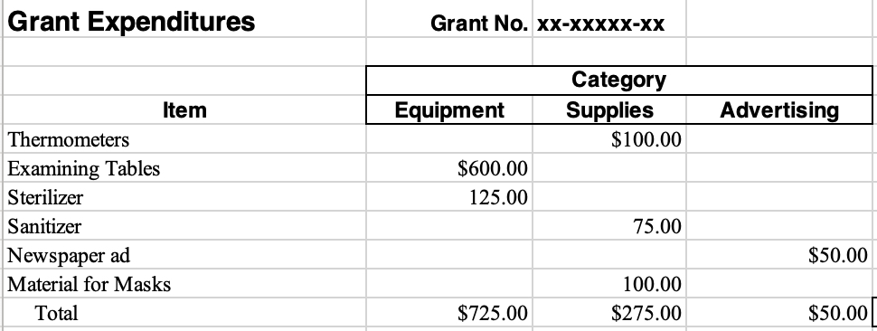
SAMPLE BUDGET

Slide 45
DISTRICT GRANT CHECKLIST
Are all District Grant & Global Grant reports up to date?
Is your club grant qualified for 23-24?
    Two club members attended DG qualification training
    Club Qualification & Club Memorandum of Understanding have been completed and sent to Pat White and David Carroll

Slide 46
DISTRICT GRANT CHECKLIST
Has someone else read the grant application for completeness?
Does the timeline match the District Grant timeline?
Do you describe how those in need will be helped?
Is there Rotarian involvement?

Slide 47
DISTRICT GRANT CHECKLIST
How can the benefits be sustained?
Has a project chair been selected & contact info provided?
Is your budget detailed and included?
Do all expenses meet grant restrictions?
Are all partners listed? Do their contributions match budget?

Slide 48
DISTRICT GRANT CHECKLIST
Is the application signed by the President or PE? Does the PE understand his or her responsibilities?
Are letters of support from cooperating partners included?
Have all documents been copied before submitting to DG committee?

Slide 49
APPLYING FOR A DISTRICT GRANT
Questions?

Slide 50
IMPLEMENTATION AND REPORTING
David Carroll
District Grants Coordinator
Pat White
District Grant Coordinator
Notes:
.

Slide 51
Objectives
Understanding how to monitor the progress of your plan
Gain best practices for managing funds and record keeping
Discuss the importance of evaluating a project and applying the lessons learned
Understand the reporting requirements

Slide 52
Successful Project Implementation
Personal Contact
Communication
Financial Management
Record Keeping
Follow the Original Plan (or Update)

Slide 53
Evaluation
Ongoing during project implementation and project completion
Based on goals set for the project
Assists with reporting requirements
Use the findings to improve future projects and identify successes you can promote!

Slide 54
District Grant Reports
Progress report is due October 1, 2023
Target date for grant completion: March 31, 2024
A final report (including receipts) is due within 2 months of project completion or by May 31, 2024 (whichever comes first)
The final report must be approved by the District Grant Team before the District pays its share of grant funding

Slide 55
District Grant Progress Report Sections
  Project Description
  Rotarian Participation
    How many?
    What have they done?
  Project Status
    What has been completed?
    What is left to complete?
    On schedule for completion?

Slide 56
District Grant Progress Report Sections
  Funding to Date
  Expenditures to Date
  Amount of District Grant Funds Expected to Be Requested
  Certification

Slide 57
District Grant Final Report Sections
  Project Description
  Rotarian Participation
    How many?
    What have they done?
  Project Impacts
    How many non-Rotarians benefited?
    Expected long term benefits?
    Role of any cooperating organization?

Slide 58
District Grant Final Report Sections
  Funding
  Expenditures
  Amount of District Grant Funds Requested
  Certification
Receipts sorted and labeled by budget category
MUST be attached to the final report!

Slide 59
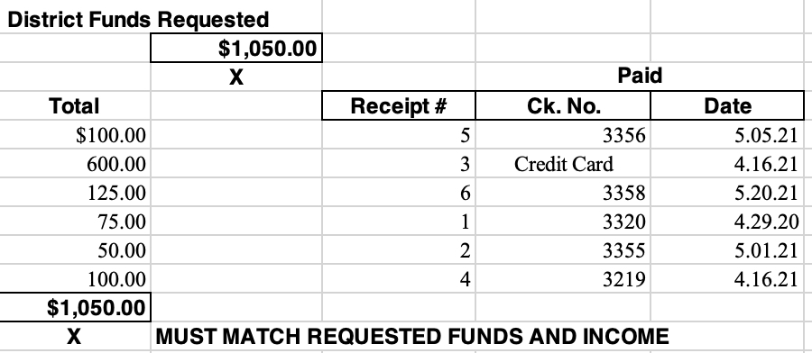
DISTRICT FUNDS REQUESTED

Slide 60
Implementation and Reporting
Questions?

Slide 61
How Did It Go?

Slide 62
DISTRICT 6780 DISTRICT GRANT CONTACTS
David Carroll, District Grants Chair
Cell: 423.595.3503 dcarroll1960@aol.com
Pat White, 23-24 District Grant Coordinator
Cell: 865.236.2072 pkmsw@aol.com

Slide 63
Thank You!

